Slide 1
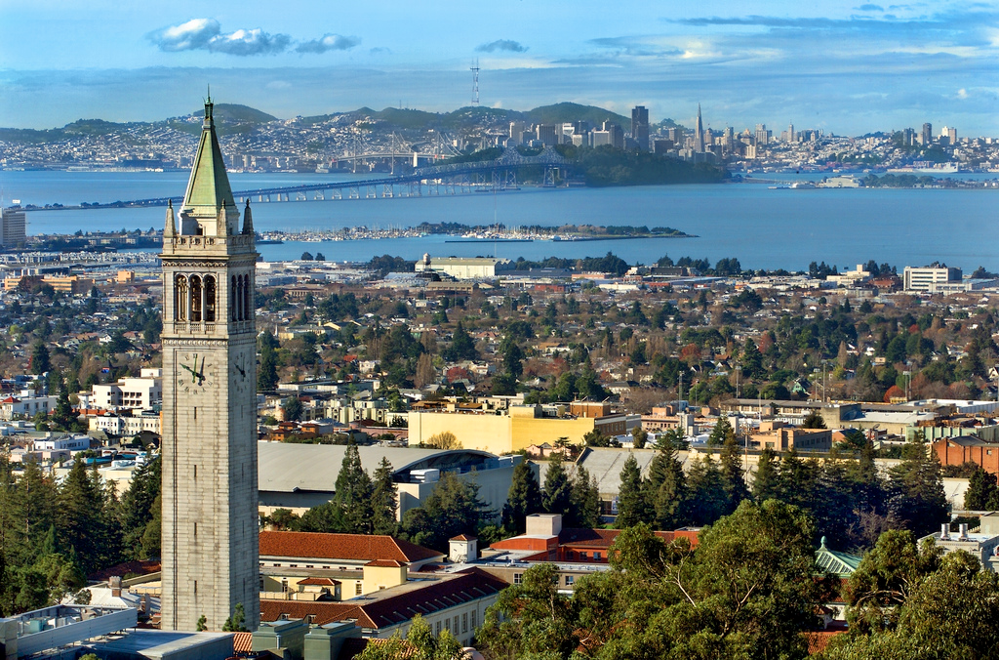
Berkeley Area Restaurant Recommendation System
Setu Upadhya
General Assembly, DAT3

Slide 2
Project Goals
Explore various algorithms to build a restaurant recommendation system
Focus on the Berkeley area to apply domain knowledge
Find new places to eat and discover trends!

Slide 3

Total Dataset:
Filtered To:
30 schools
13k businesses
330k reviews
131k users
122 MB
1 school
235 restaurants
25k reviews
10k users
2 MB
Business data: Category, location, # reviews, average stars, review IDs
Review data: Review text, review stars, useful, funny, cool, business IDs, user IDs
User data: Review Ids
Data from 2007 thru mid 2012

Slide 4

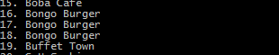
Minor data wrangling

Slide 5
Approach 1: Similar restaurant (by user reviews)
Ask user to select a restaurant
Load Yelp user data in the form:
User ID : Business ID: Review
Use Recsys package to determine the restaurants with the closest Euclidian distances
Results:
RMSE: around 1.0, MAE: around 0.8
Match rating around 0.2-0.4.
Subjective feedback:
First glance: Matches don’t make much sense (usually recommending different categories, etc.)
Further review: Matches relate more to location, price, “cool” factor
Learning: One restaurant is not enough!

Slide 6
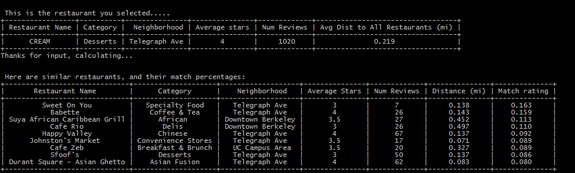
Approach 1 (Example)....

Slide 7
Approach 2: User Review Based (part 2)
Ask user to rate multiple restaurants
Generate preference vector for the user
Calculate match between user’s preference vector and restaurants in database. Return top results.
Results:
Algorithmic match is much stronger
Often estimates >5 stars for user’s predicted review
Quite strong relative to RMSE/MAE
Subjective feedback: Matches make more sense!
Still rationale for some matches is not apparent

Slide 8
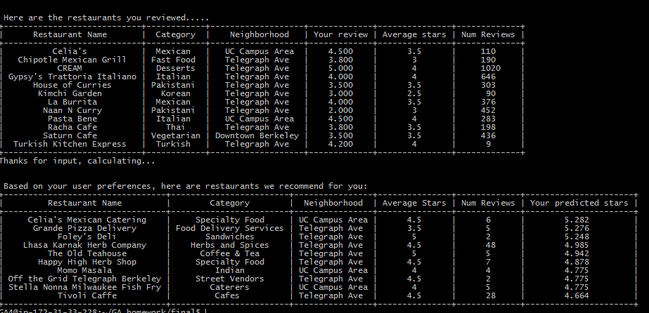
Approach 2 (Example, based on me!)....

Slide 9
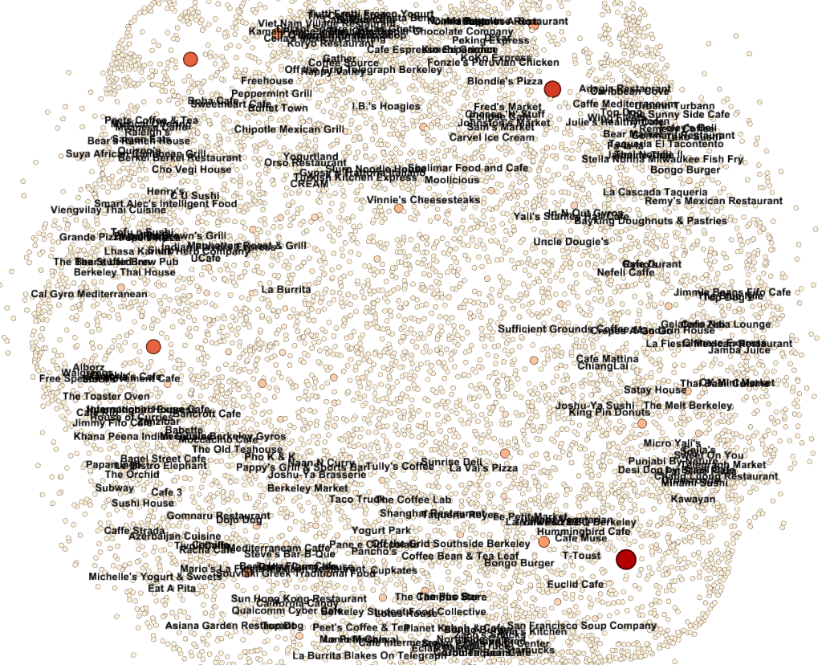
Gephi Visualization
Showing only “affinity connections”
(Reviews with 4-5 stars)

Slide 10
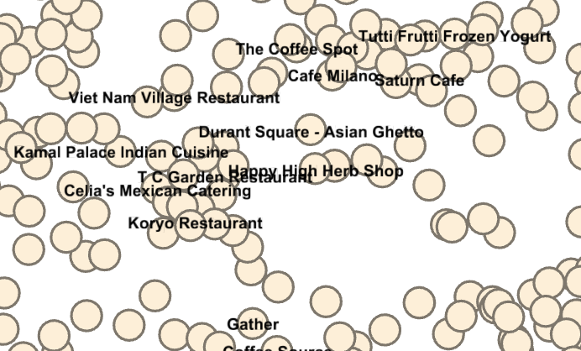
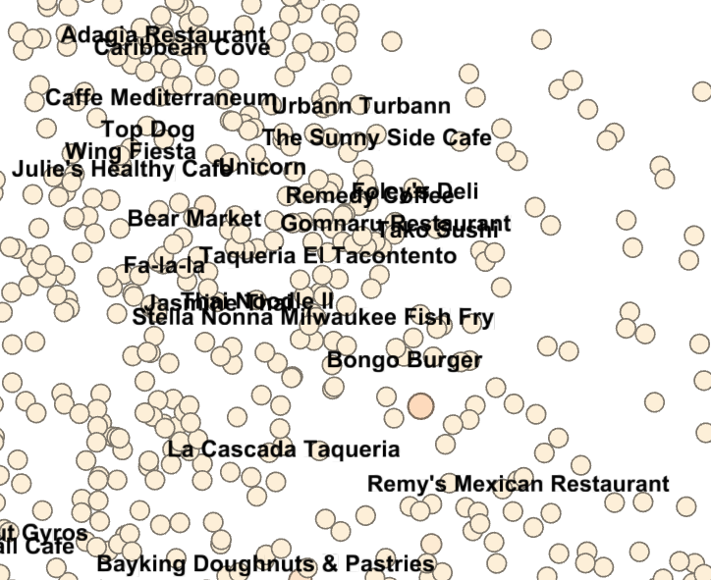
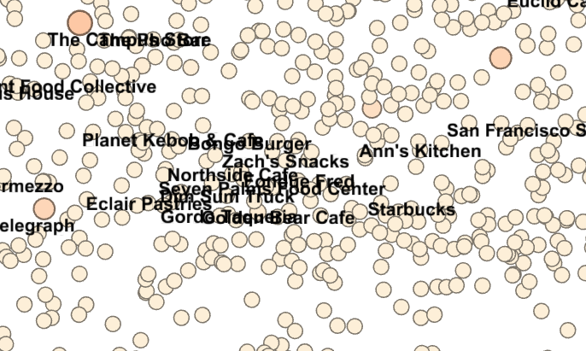

Slide 11
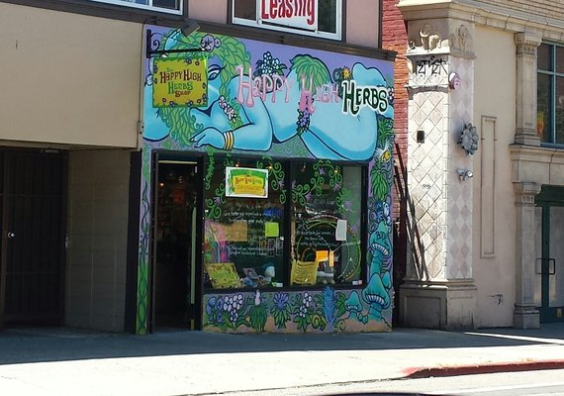
The Mystery: Why this place??
“This store services a body that is vibrating higher than most. Inspire creativity? There's some thing for that. Clean out your body after a weekend of mind expanding experiences, they have that. Supercharge your body with herbs that keep your stress levels balanced, they have those. Need a hula hoop for Flow? Got 'em. I'm betting to guess this store has a crowd that is open to more…I call them multidimensional” – Yelp Review

Slide 12
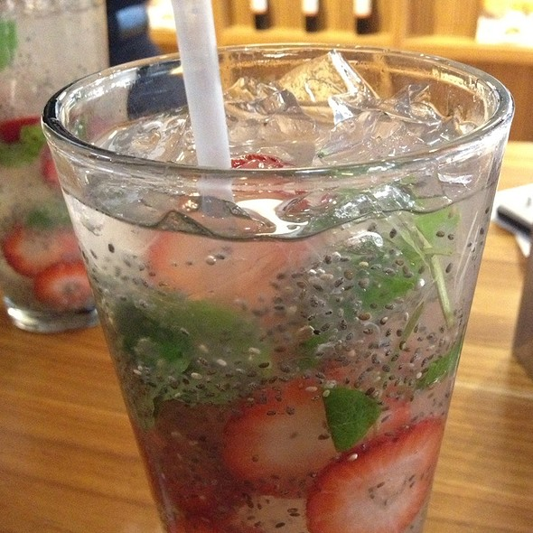
Mystery Solved!
“Their prices for chia seeds are so much better than anyone else's and the quality is great.” – Yelp review
My favorite drink →
A novel connection discovered through ML!

Slide 13
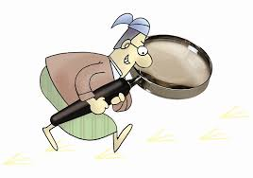
Approach 3: Restaurant Feature Based
Thought process: How do you normally search for restaurants?
Developed sparse matrix on restaurant features (80+ categories, location, popularity, etc.)

Slide 14
Types of Categories:
African, American (New), American (Traditional), Arts & Entertainment, Asian Fusion, Bagels, Bakeries, Barbeque, Bars, Beauty and Spas, Beer, Wine & Spirits, Books, Mags, Music and Video, Brazilian, Breakfast & Brunch, Buffets, Burgers, Cafes, Candy Stores, Caribbean, Caterers, Chicken Wings, Chinese, Chocolatiers and Shops, Coffee & Tea, Convenience Stores, Creperies, Delis, Desserts, Dim Sum, Donuts, Drugstores, Ethiopian, Ethnic Food, Event Planning & Services, Fast Food, Filipino, Fish & Chips, Fondue, Food, Food Delivery Services, Food Stands, Food Trucks, Greek, Grocery, Halal, Health Markets, Herbs and Spices, Hot Dogs, Ice Cream & Frozen Yogurt, Indian, Italian, Japanese, Juice Bars & Smoothies, Korean, Latin American, Live/Raw Food, Mediterranean, Mexican, Middle Eastern, Music & DVDs, Music Venues, Nightlife, Office Equipment, Pakistani, Persian/Iranian, Pizza, Pubs, Restaurants, Salad, Sandwiches, Shopping, Soup, Specialty Food, Sports Bars, Street Vendors, Sushi Bars, Thai, Turkish, Vegan, Vegetarian, Vietnamese

Slide 15
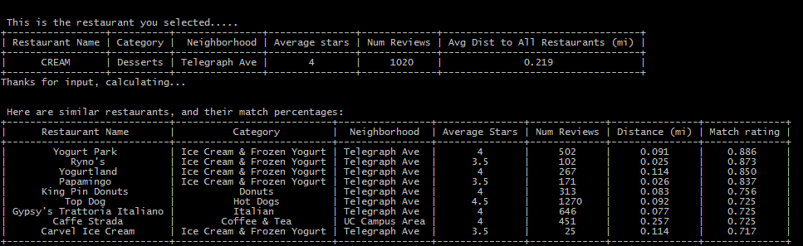
Approach 3 (Example)
Safer approach, fewer false positives
Less insightful, fewer true positives
Results closer to Yelp
Although Yelp says “People also viewed…” (they must be using ensemble technique)
RMSE: 0.23, MAE: 0.07

Slide 16
Time for a demo…

Slide 17
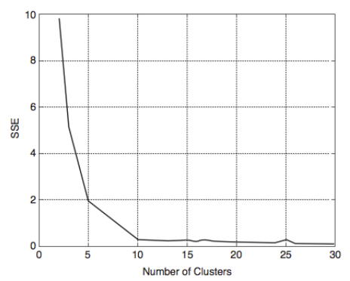
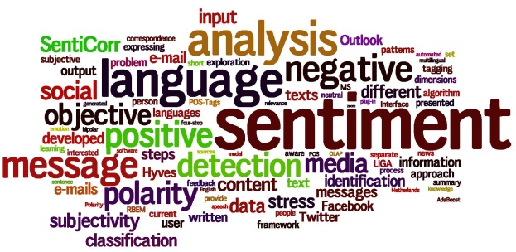
Ideas for future analysis
Clustering analysis: How many clusters? What drives clustering?
Validate matches with real users (perhaps using Crowdflower, et. al). Calculate ROC curve
Use more data (text of review, review time of day, reviewer gender, age, etc.)

Slide 18
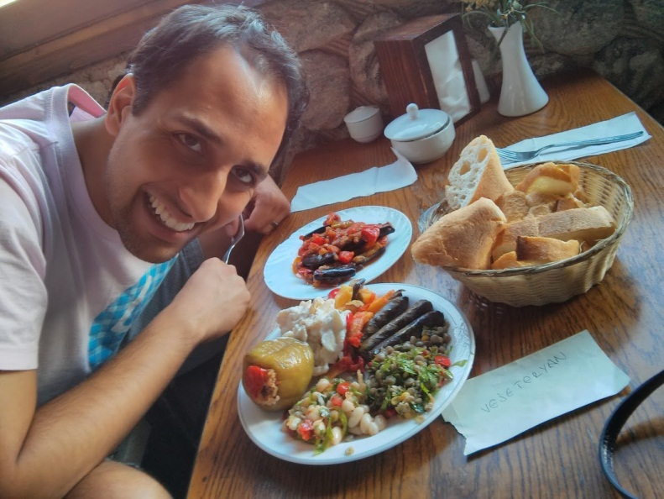
Conclusions
Machine learning can generate novel results!
Balance between insightful and expected results is important when designing a recommendation engine (recall vs. precision)
Always more ways to analyze data, optimize
Hacking builds your appetite, so…
LET’S EAT!!
Setu Upadhya
setman85@gmail.com
https://github.com/setman85/

